Slide 1
ES6

Slide 2
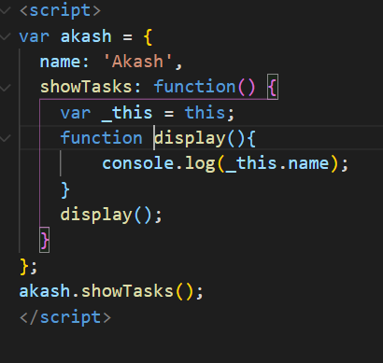
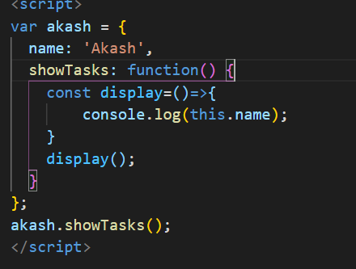
This keyword in normal function and arrow function

Slide 3
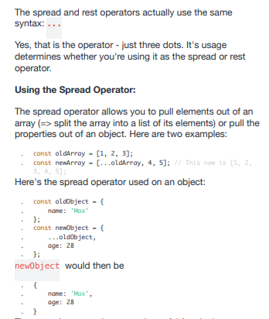
Spread and rest parameter

Slide 4
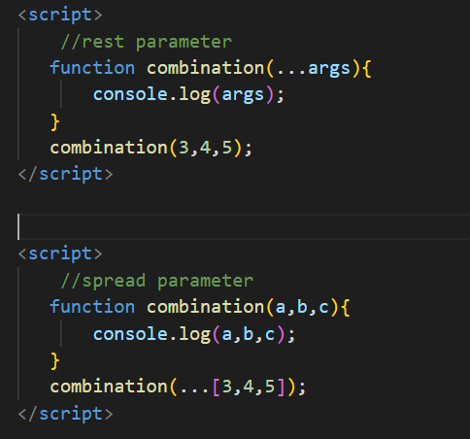
Rest And Spread Parameter

Slide 5
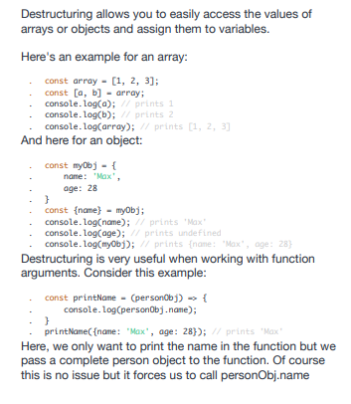
Destructing

